Slide 1
Green Storage System
Market Research

Slide 2
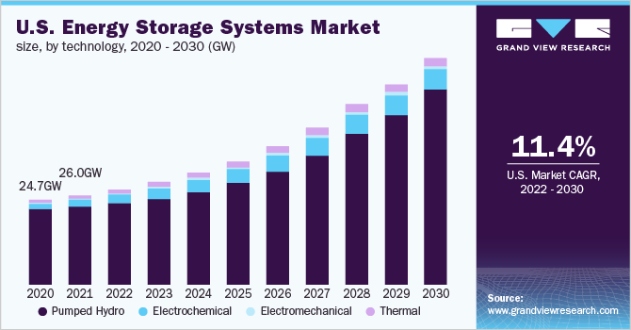
Energy Storage System Market
Valued 211.24 GW in 2021 and is progressing at a compound annual growth rate (CAGR) of 11.0% from 2022 to 2030.
Valued at $188.5 billion in 2020, and is projected to reach $435.4 billion by 2030, growing at a CAGR of 8.3% from 2021 to 2030.
Asia-Pacific, followed by Europe and North America, to maintain its dominance by 2030.
Energy Storage Systems Market Size Report, 2030 (grandviewresearch.com)
Energy Storage Systems Market to Reach $435.4 Bn, Globally, by 2030 at 8.3% CAGR: Allied Market Research (prnewswire.com)

Slide 3
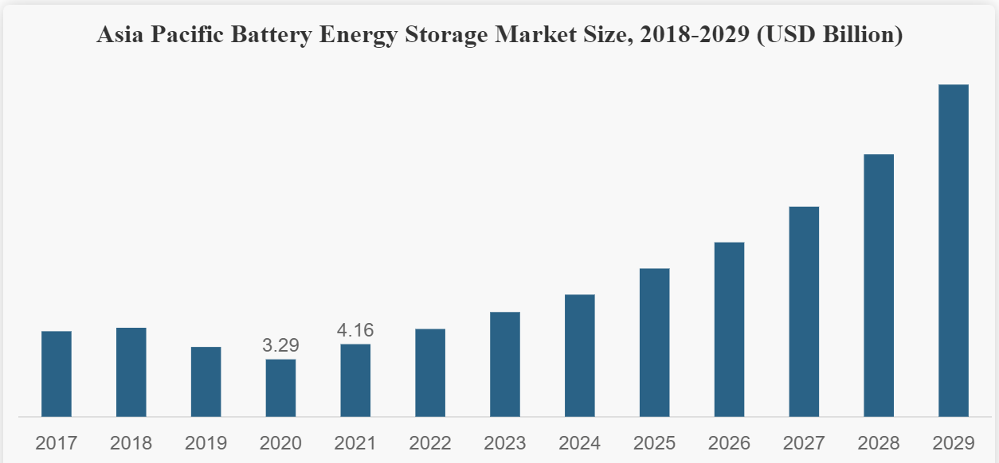
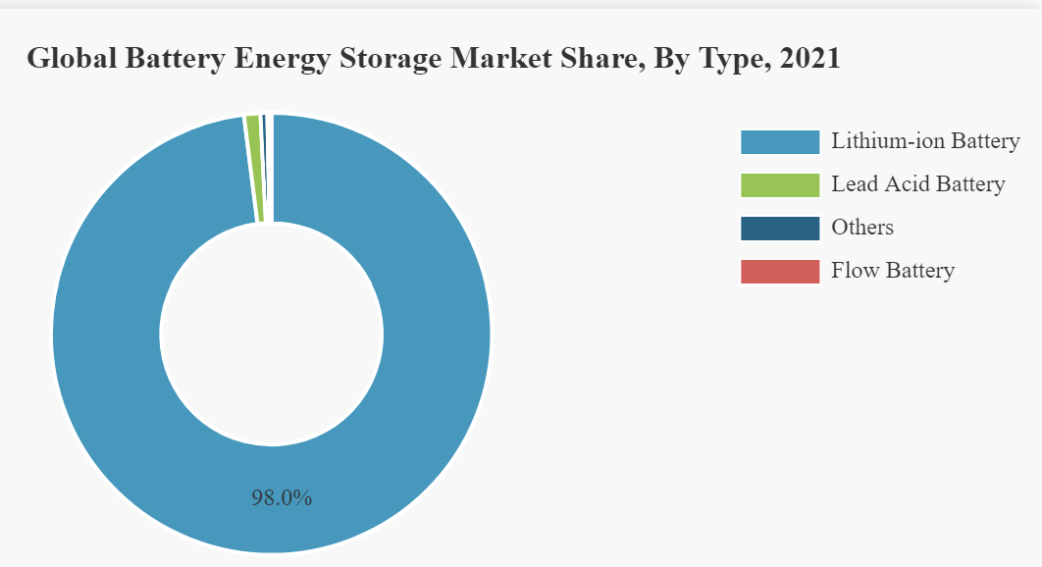
Battery Energy Storage Market
Battery Energy Storage Market Size, Share | Growth [2022-2029] (fortunebusinessinsights.com)
Battery Energy Storage System Market Size & Share | Industry Report, 2022-2027 | MarketsandMarkets™

Slide 4
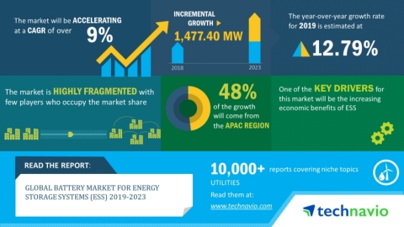
Battery Market for Energy Storage Systems
Battery Market is poised to grow by 1477.40 MW in terms of units during 2019-2023, progressing at a CAGR of over 9% during the forecast period.
Battery Market for Energy Storage Systems (ESS) 2019-2023 | Evolving Opportunities with Kokam and LG Chem | Technavio | Business Wire

Slide 5
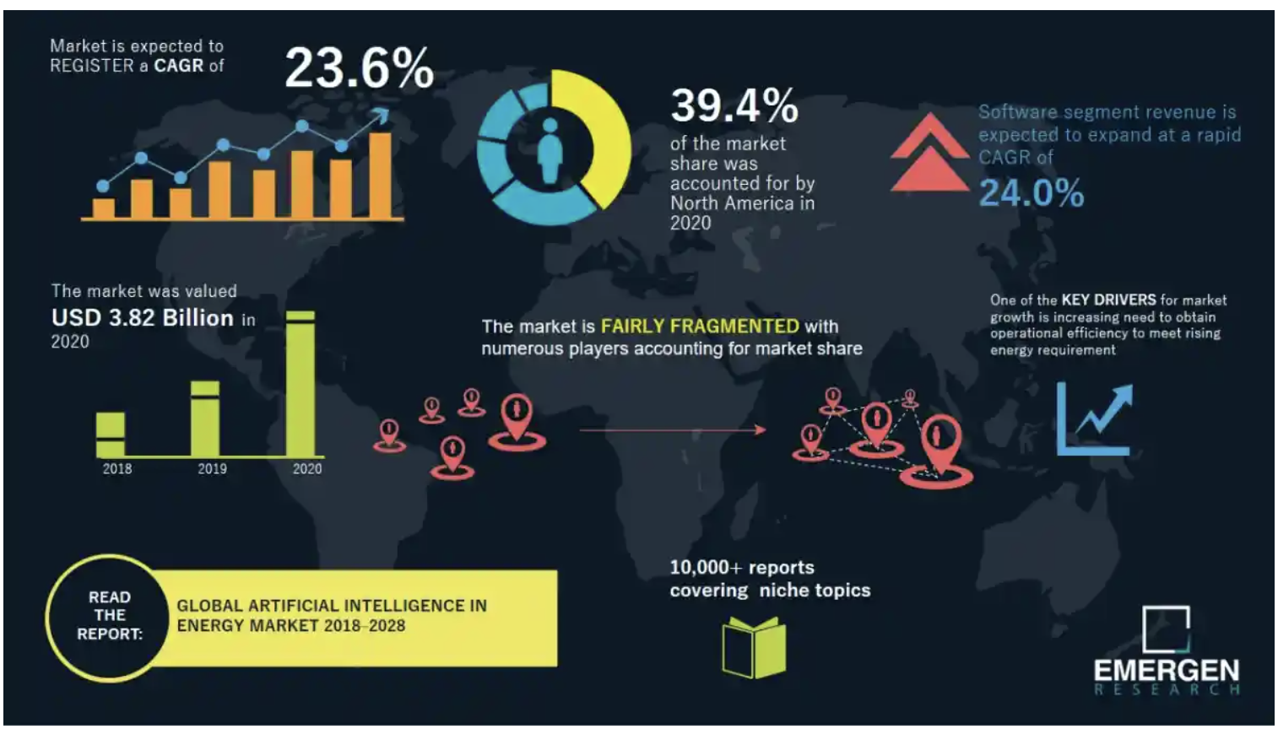
AI in Energy Market
AI in Energy Market Size USD 20.83 Billion by 2028 | Artificial Intelligence in Energy Industry Growth 23.6% CAGR (emergenresearch.com)

Slide 6
AI in Energy Storage Market
The growing importance of battery technology, energy storage deployments enjoyed 93% growth year-over-year up to the start of Covid-19. And the market is expected to enjoy an 8-fold increase in value from 2020 to 2024.
Link - https://www.veritone.com/blog/using-ai-to-mitigate-merchant-energy-storage-risks/
Stanford scientists combine AI and atomic-scale images in pursuit of better batteries.
Article - Stanford scientists combine AI and atomic-scale images in pursuit of better batteries
Paper - Correlative image learning of chemo-mechanics in phase-transforming solids | Nature Materials

Slide 7
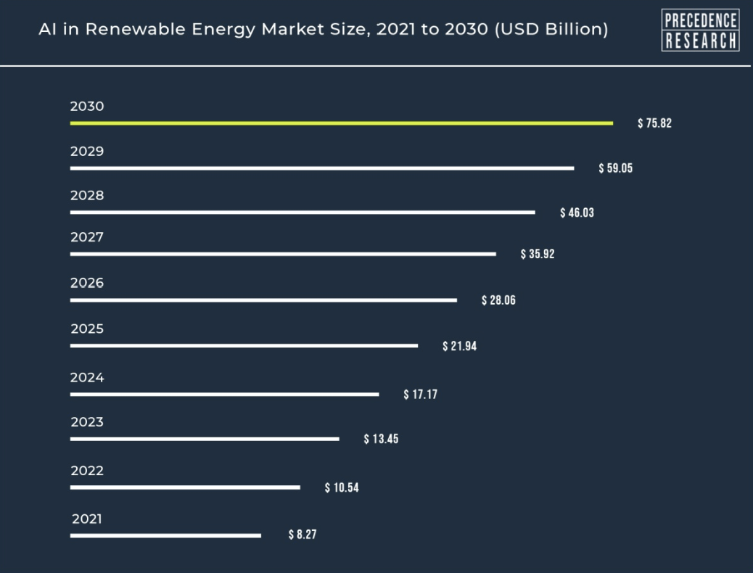
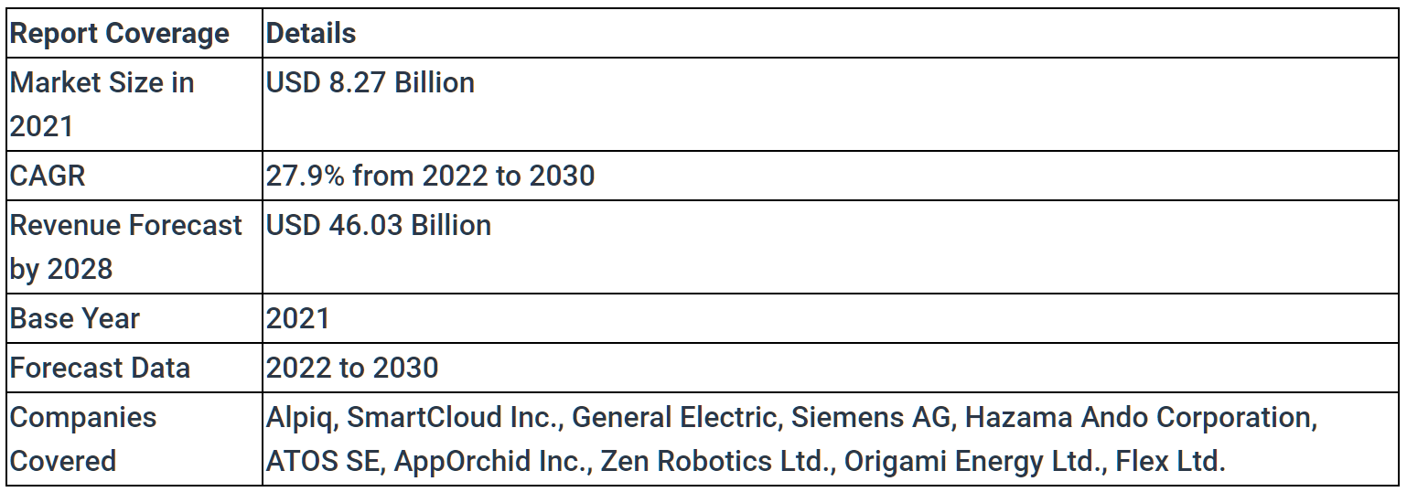
AI in renewable energy market
AI in Renewable Energy Market Size to Surpass US$ 75.82 Bn (globenewswire.com)

